Slide 1

PYTHON GENERATIVE:
NFT
EIT CSE
KARAN SINGH BISHT 19-CSE-45

Slide 2
CONTENTS OF THIS PROJECT
Generative art NFT collections are made up of a set of unique digital artworks released by an artist or group of artists
With the help of python
LANGUAGE | PYTHON SCRIPT TO GENERATE NFT
USED AND ALTERNATIVE RESOURCES | OPEN AI TO PROMPT AND NAME THEM
CONTRACT | ERC 721 SMART CONTRACT OR OPENSEA
COLORS | All the colors used in this presentation RGB
INFOGRAPHIC RESOURCES | REACT to show images
COLLECTION | Python3 resart.py -n 32 –collection “foo”
For more info: Karan singh bisht

Slide 3
TABLE OF CONTENTS
01
02
INTRODUCTION
TERMINOLOGY
03
APPLICATIONS
ABOUT AND CODE
CODE AND EXECUTION
USES AND OUTPUT

Slide 4
01
INTRODUCTION
WHAT IS A GENERATIVE ART WORK REALLY IS ?

Slide 5
INTRODUCTION
Generative art" often refers to algorithmic art (algorithmically determined computer generated artwork) and synthetic media (general term for any algorithmically-generated media)

Slide 6
—ANUJ JASANI
“The virtual world will open thousands of new opportunities for this new generation one is NFT ”

Slide 7
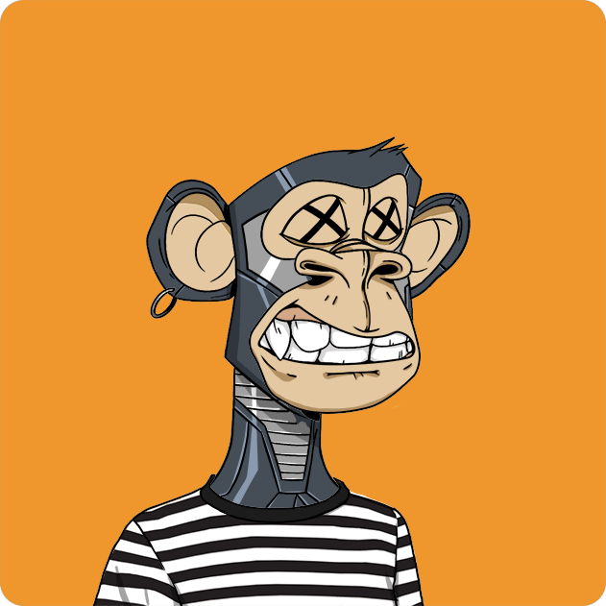
WHAT IS NFT
A non-fungible token (NFT) is a digital asset that is verifiable on blockchain technology. It can be :
ART & ARTWORK
MUSIC AND VIDEOS
IN GAME ASSETS
Because they are unique, NFTs are becoming sought after as collectibles.

Slide 8
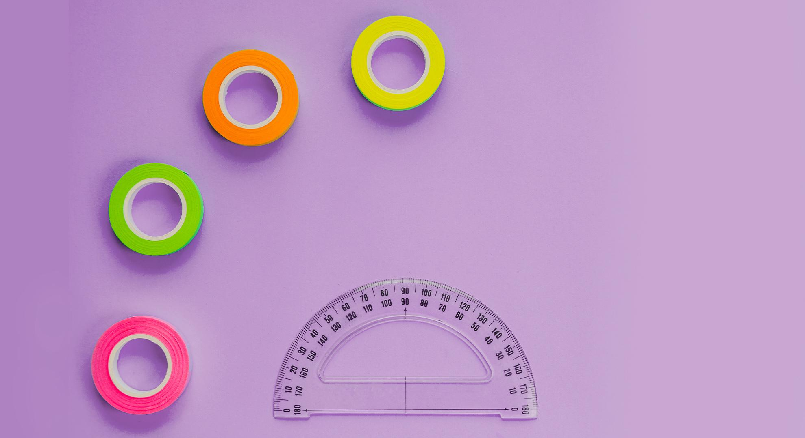
CREATING NFT’S USING PYTHON

Slide 9
IMPORTANT FUNTIONS
Def generate_art()
def random_color()
Generating our art work with the help of pillow and by creating a image module
I want a bright, vivid color, so max V and S and only randomize HUE we create random colour

Slide 10
$1.6billion
NFT MARKETPLACE VALUATION

Slide 11
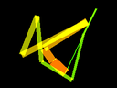
WHOA!
You can start generating nft’s and uploading it on opensea for free or you can use ERC 721 which is paid

Slide 12
1.
2.
3.
4.
Set size parameters
Create the directory and base image
Generate points to draw
Generate the image

Slide 13
TERMINOLOGY
02

Slide 14
TERMINOLOGY
-n
–collection
IMAGEDRAW
IMAGECHOPS
No of images you want to create
Name your collection whatever you want to create
Drawing points and connecting lines
special effects, image compositions, algorithmic painting,

Slide 15
CODE WORKING
STEP 1
STEP 2
STEP 3
Where we are going to put it and creating a blank canvas
Creating random points and connecting the lines
Coloring the lines with vibrant random colors

Slide 16
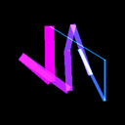

OUTPUT AND POSSIBILITIES
You can create and sell your own NFT collection using platforms like Appy Pie, OpenSea, Rarible, etc., and make money with your digital assets. You can even list your NFT’s on other marketplaces.
To look for collections, click here ⮕

Slide 17
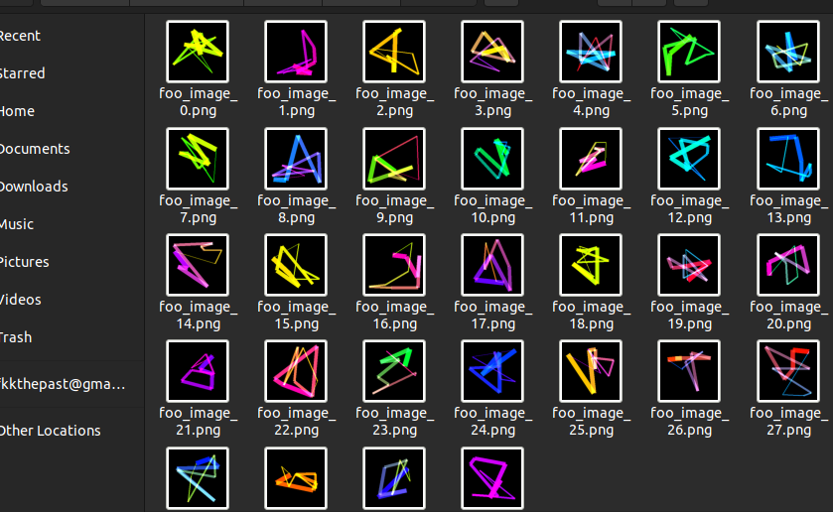
OUTPUT OF PROGRAMM

Slide 18
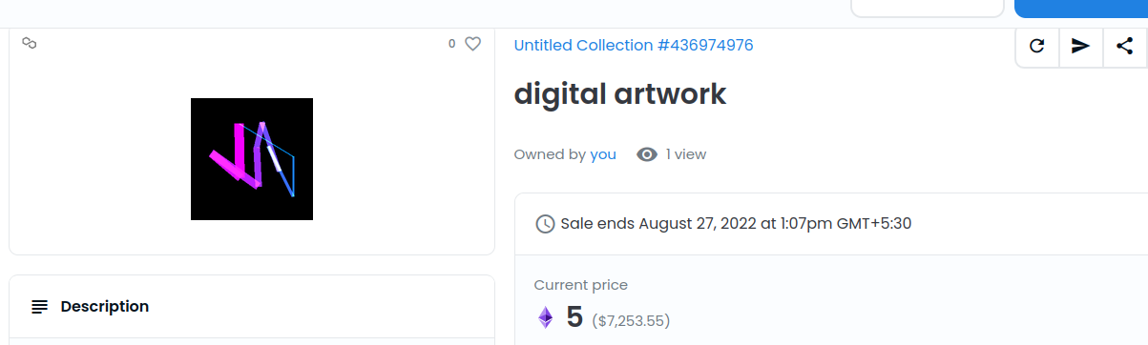
OUTPUT ON OPENSEA

Slide 19
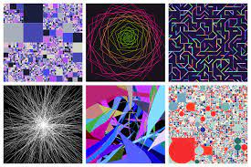
SCOPES FOR IMPROVEMENT
WE CAN ADD
A BACKGROUND IMAGE
INSTEAD OF BLACK BG
MAKING BETTER PIXELS
GETTING THE
OUTPUT IN ETH
CONTRACT RATHER IN PNG
AUTOMATING UPLOADING
TO OPEN SEA

Slide 20
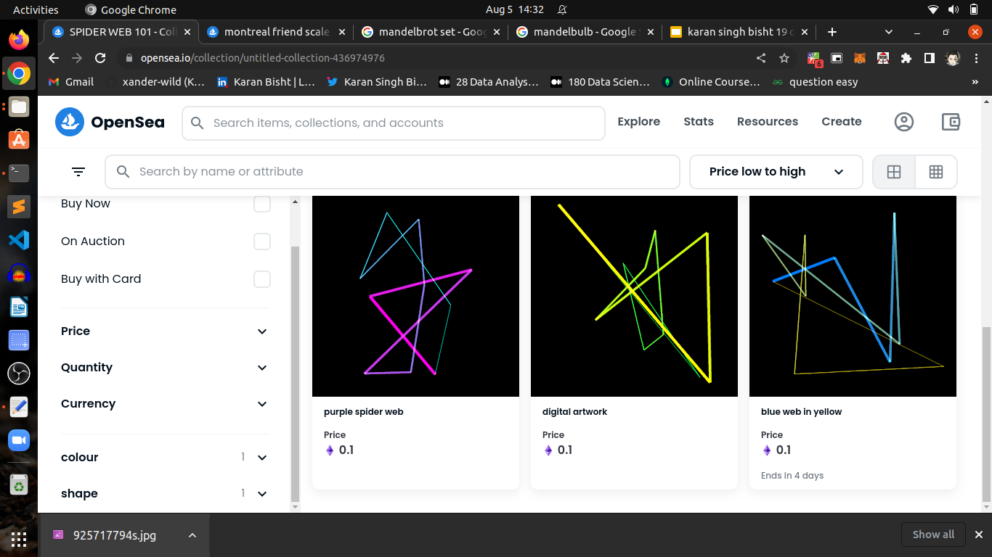

Slide 21
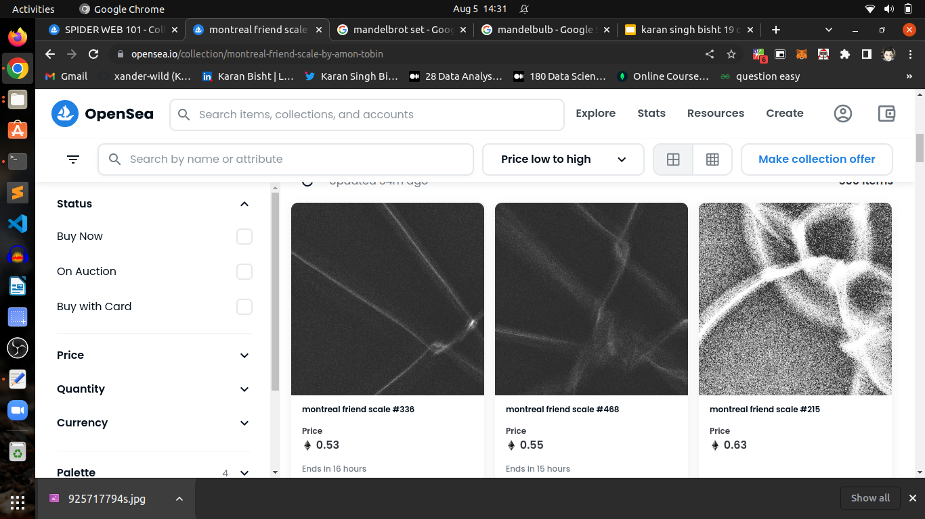

Slide 22
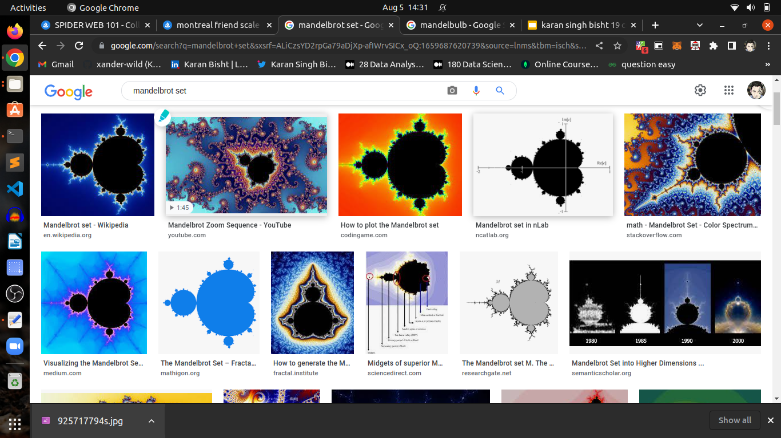

Slide 23
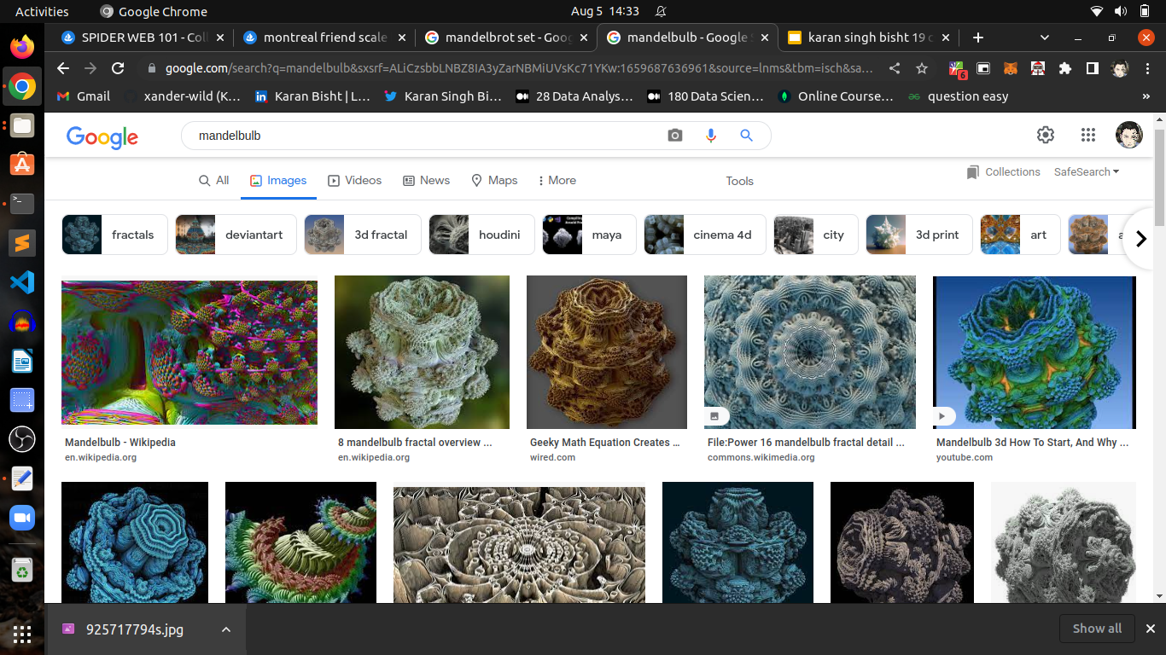

Slide 24
THANK YOU

